Slide 1
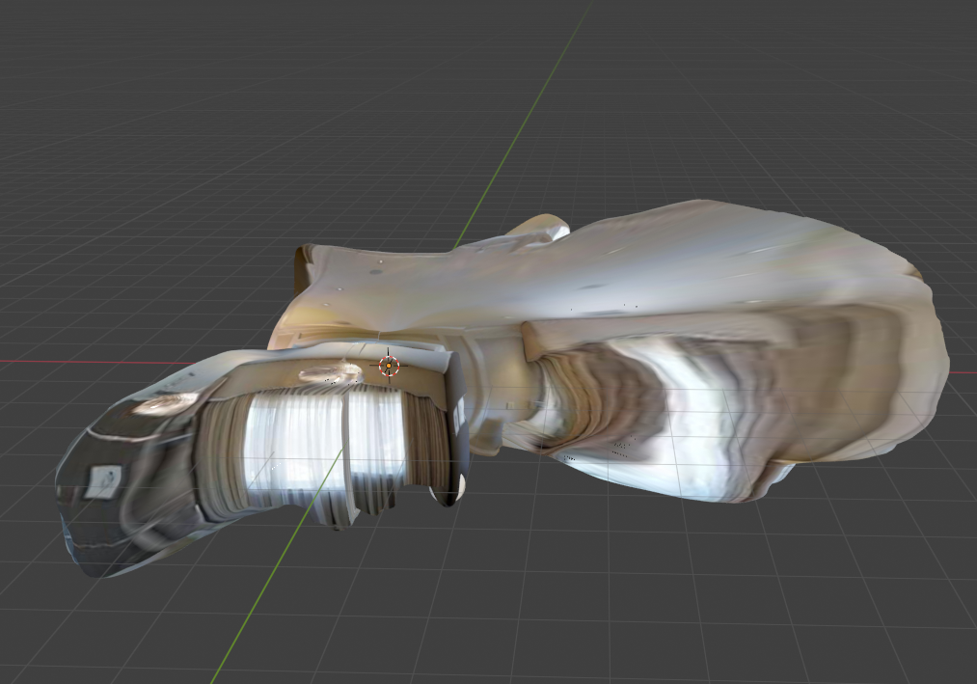
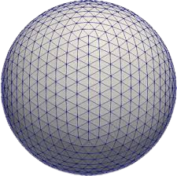
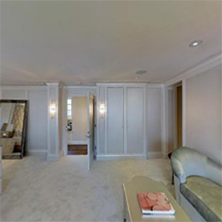
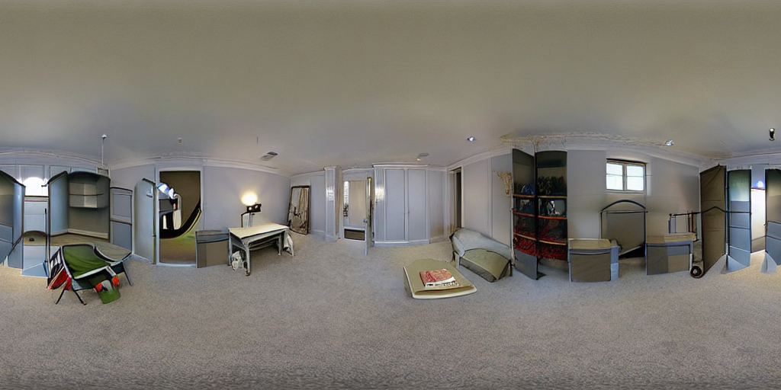

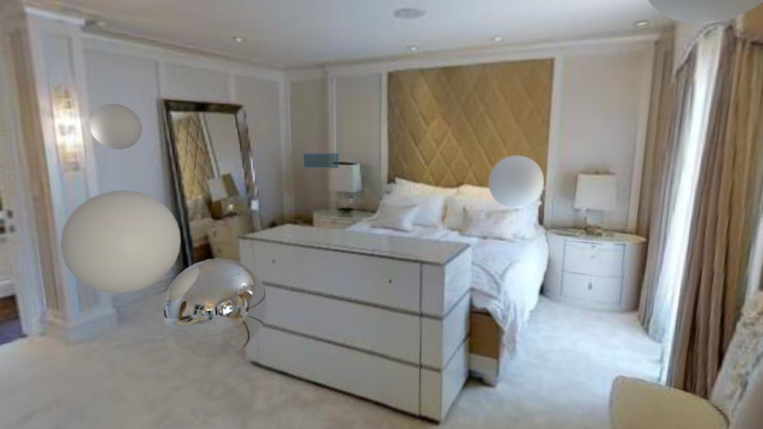
3.3. HDR PANORAMA
3.5. EMISSIVE MESH
CG OBJECT
LDR LFOV IMAGE
3.2. LDR PANORAMA
MULTIPASS COMPOSITING (Fig. 5)
3.4. DEPTH ESTIMATION

